Slide 1
An information-theoretical approach to internal models in a Partially Observable Markov Decision Process
By Lukas Prader
Supervisors: Alexander Vining, Hans J. Briegel Group: Quantum Information & Computation

Slide 2

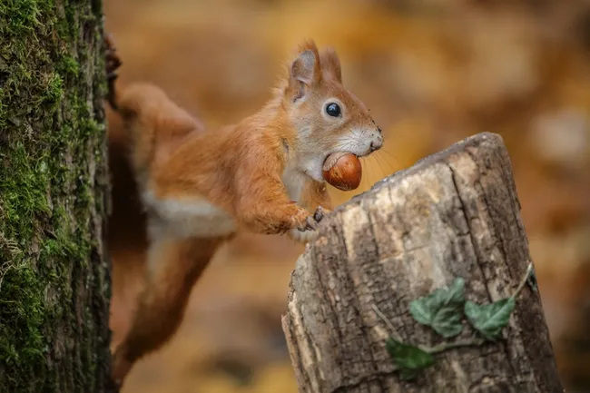
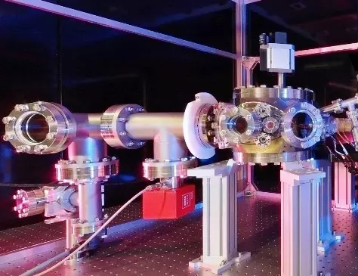
How can an agent learn about the structure of its environment?
https://www.westend61.de/en/photo/FO006476/brazil-mato-grosso-mato-grosso-do-sul-pantanal-giant-anteater-and-termite-hill
https://www.livescience.com/64104-how-do-squirrels-find-buried-nuts.html
https://www.uibk.ac.at/exphys/index.html.en

Slide 3
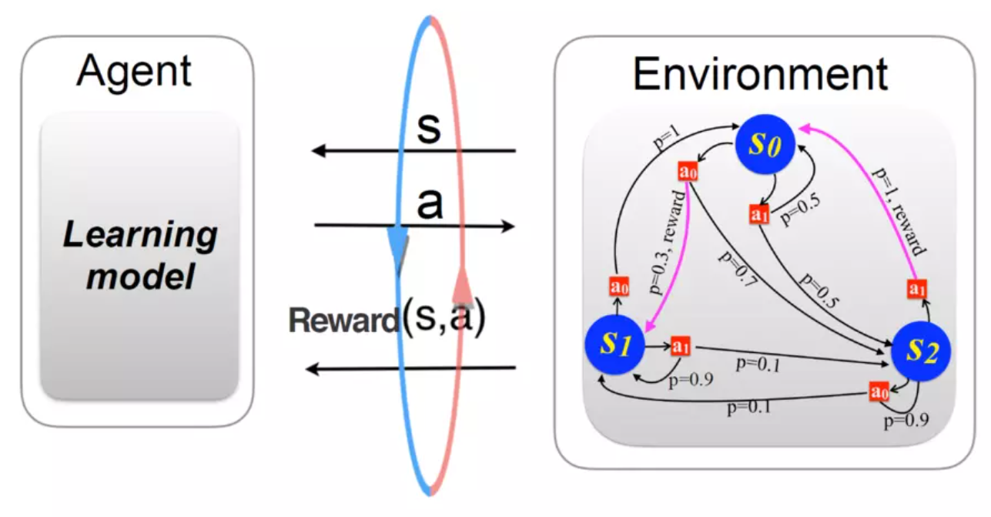
How can an agent learn about the structure of its environment?
https://www.uibk.ac.at/th-physik/qic-group/research/topics/ai-and-science/

Slide 4
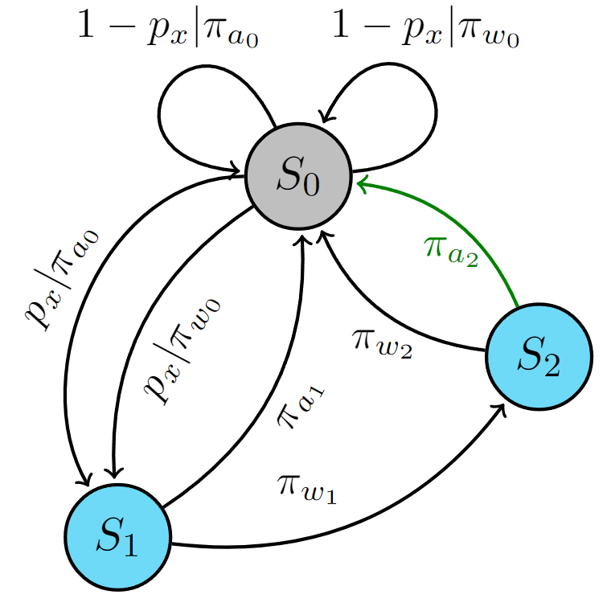
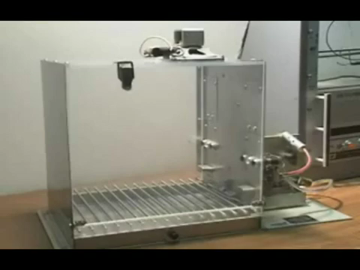
The Skinner Box as a Partially Observable Markov Decision Process
https://www.youtube.com/watch?v=lxImLwqY0Jc&t=1s
Notes:
What observations are needed to understand this process?
While only observing the light, can an observer infer the existence of “hidden” states?

Slide 5
The Skinner Box as a Partially Observable Markov Decision Process cont.
What observations are needed to understand this process?
While only observing the light, can an observer infer the existence of “hidden” states?
Notes:
Delayed action problem

Slide 6
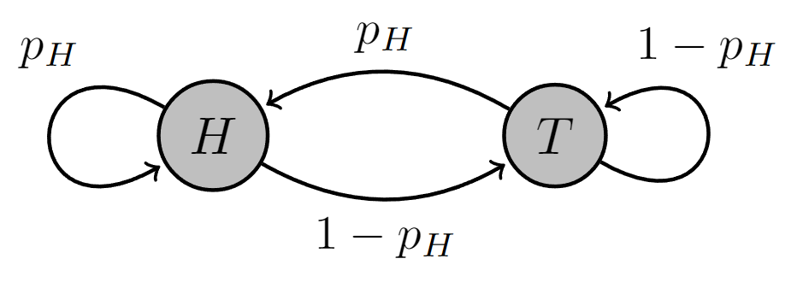
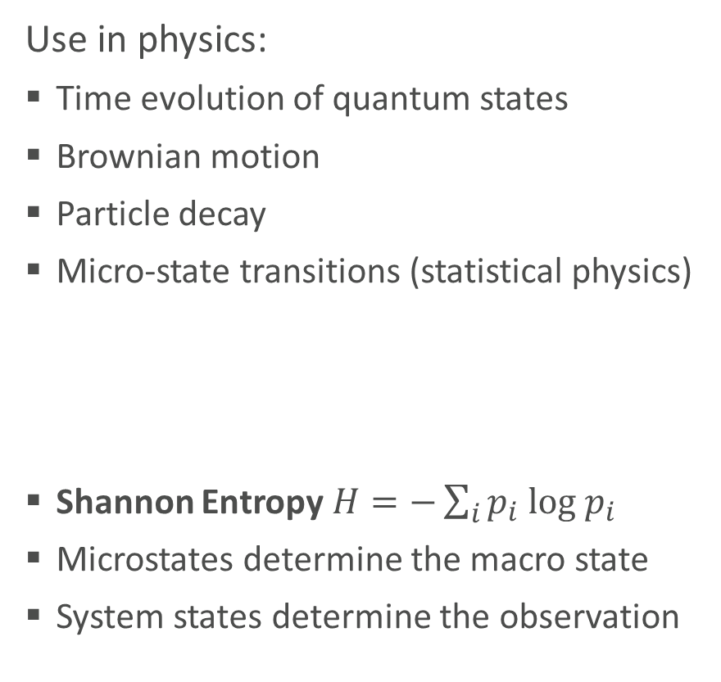
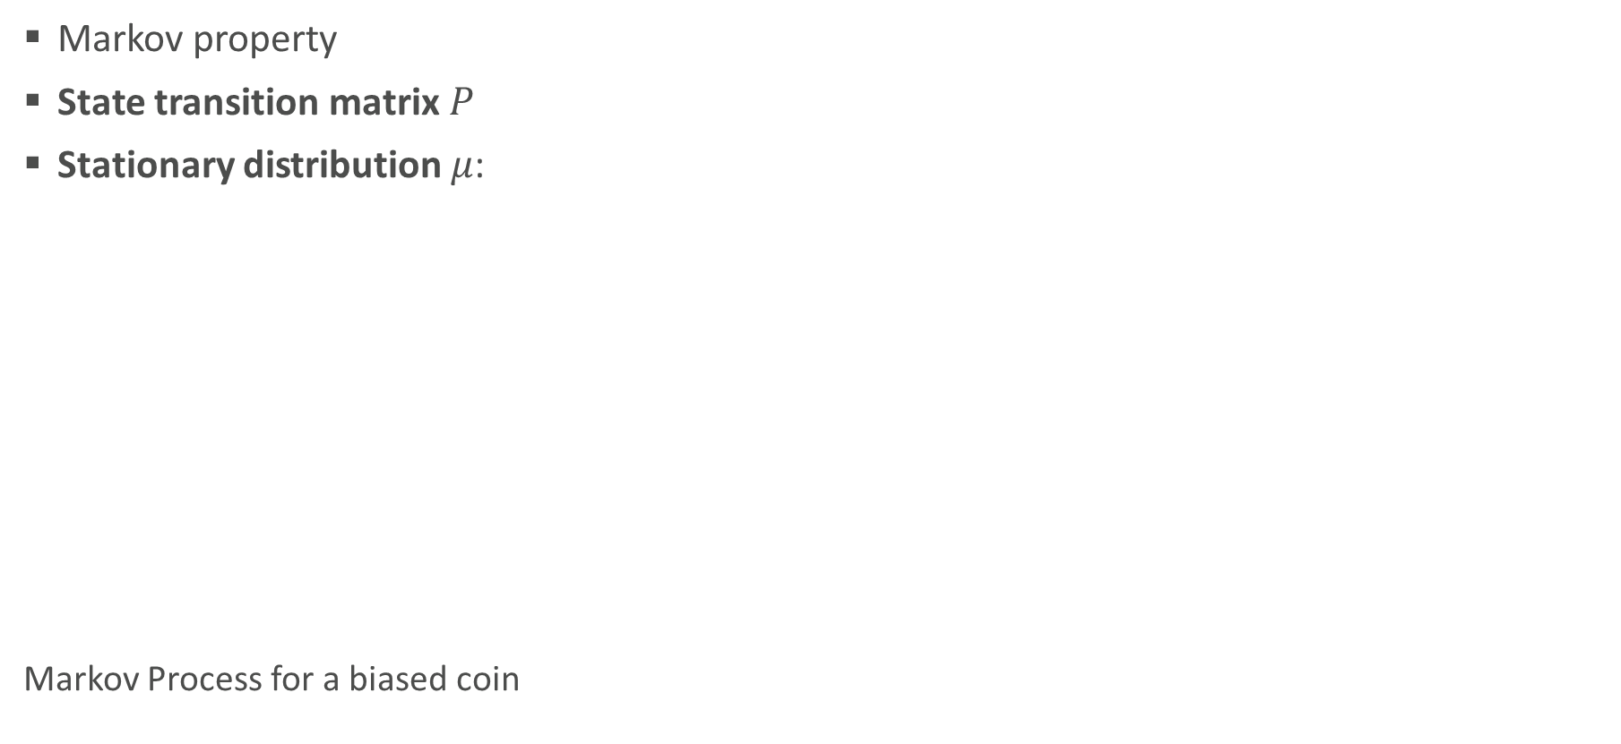
Markov Processes and Information Theory
Markov property
State transition matrix $P$
Stationary distribution $μ$:
Markov Process for a biased coin
Use in physics:
Time evolution of quantum states
Brownian motion
Particle decay
Micro-state transitions (statistical physics)
Shannon Entropy $H=−\sum_{i}{p_{i} log{ p}_{i} }$
Microstates determine the macro state
System states determine the observation
Cover & Thomas, Elements of Information Theory

Slide 7
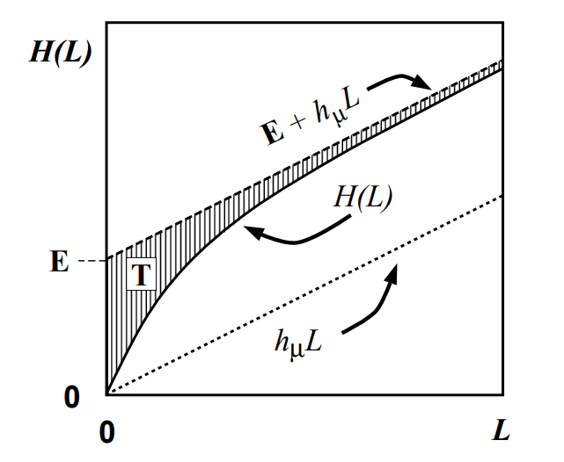
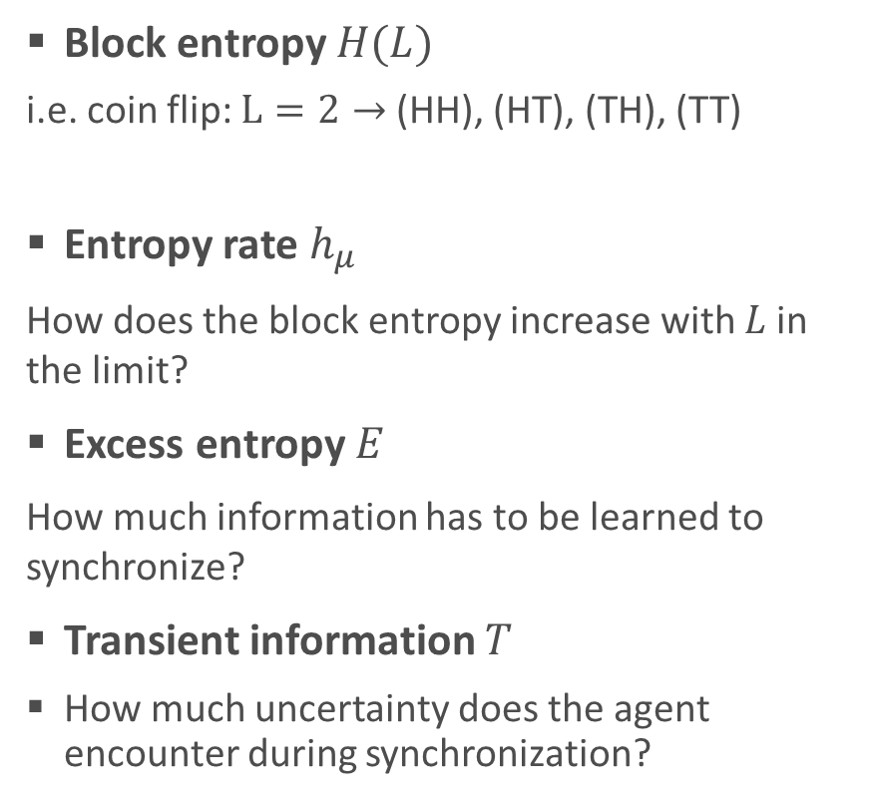
Information Theory and Synchronization
Block entropy $H(L)$
i.e. coin flip: $L=2→$ (HH), (HT), (TH), (TT)
Entropy rate $h_{μ}$
How does the block entropy increase with $L$in the limit?
Excess entropy $E$
How much information has to be learned to synchronize?
Transient information $T$
How much uncertainty does the agent encounter during synchronization?
Learning as “synchronization” to the environment
Crutchfield & Feldman, 2003

Slide 8
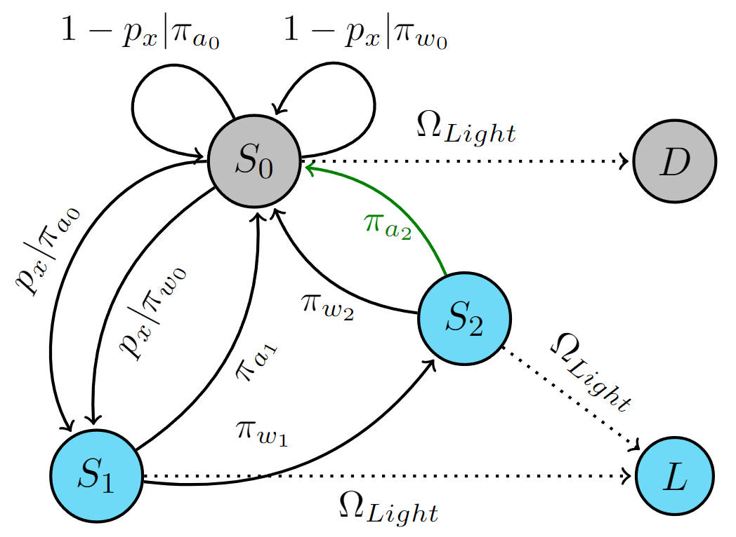
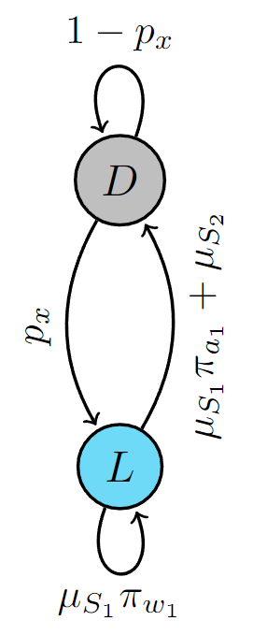
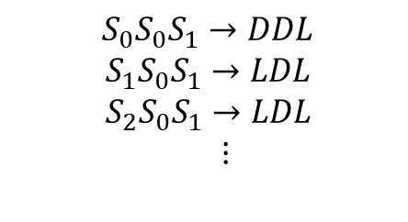
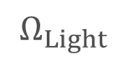
Reducing the delayed action MDP
Only parts of the process can be observed
The process is assumed to already be in stationarity
$$S_{0}S_{0}S_{1}→DDL$$
${ S}_{1}S_{0}S_{1}→LDL$
${ S}_{2}S_{0}S_{1}→LDL$
$⋮$
MP1
MDP
$$Ω_{Light}$$

Slide 9
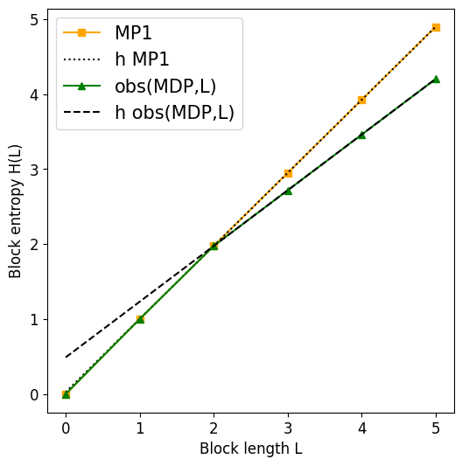
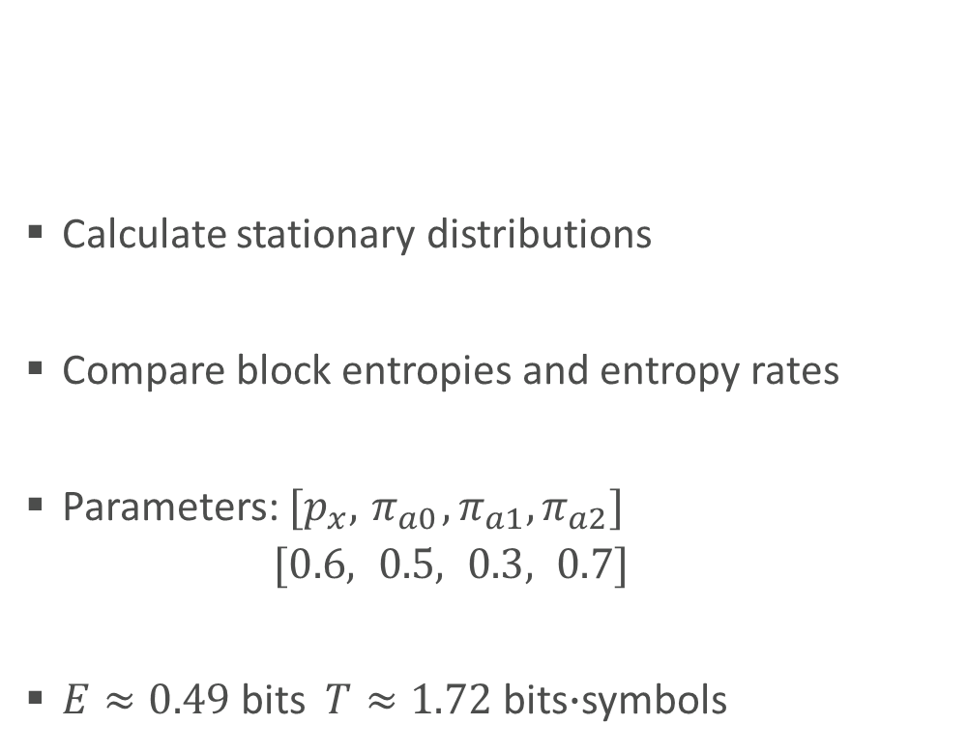
Analysing the block entropy behaviour
Calculate stationary distributions
Compare block entropies and entropy rates
Parameters: ${[p}_{x},{ π}_{a0}, π_{a1}, π_{a2}]$
$[0.6, 0.5, 0.3, 0.7]$
$E≈0.49$ bits $T≈1.72$ bits$∙$symbols

Slide 10
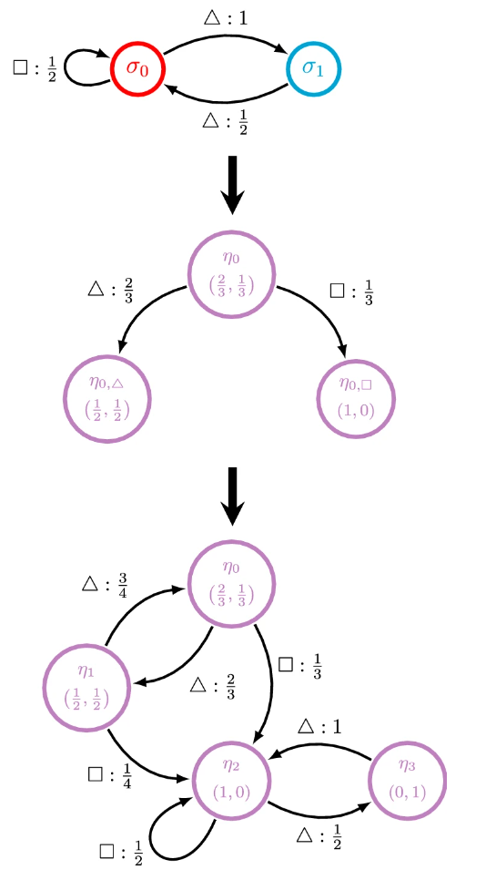
Use for internal model generation
Synchronization as an indicator for sufficient information
Creation of an “ϵ-machine” using the recurrent part of a mixed-state system
Using the information to optimize the policy, relating to reward
Jurgens & Crutchfield, 2021

Slide 11
Conclusion
The necessary length of observations for understanding the light behaviour of the delayed action task is L=2.
Information theoretical measures can be used to understand the process of internal model formation.

Slide 12
Literary sources
Cover & Thomas: Elements of Information Theory, 1999
Crutchfield & Feldman: Regularities Unseen, Randomness Observed: Levels of Entropy Convergence, 2003
Jurgens & Crutchfield: Shannon entropy rate of hidden Markov processes, 2021

